Slide 1
Machine Learning Basics

Slide 2
OUTLINE
1. Learning Problems
2. Theory of Generalization
3. Over-fitting & Validation
4. Parameter Estimation
5. Supervised and Unsupervised Learning Algorithms
6. Challenges Motivating Deep Learning

Slide 3

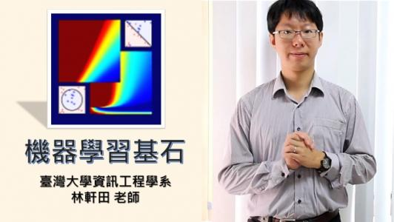
REFERENCE

Slide 4
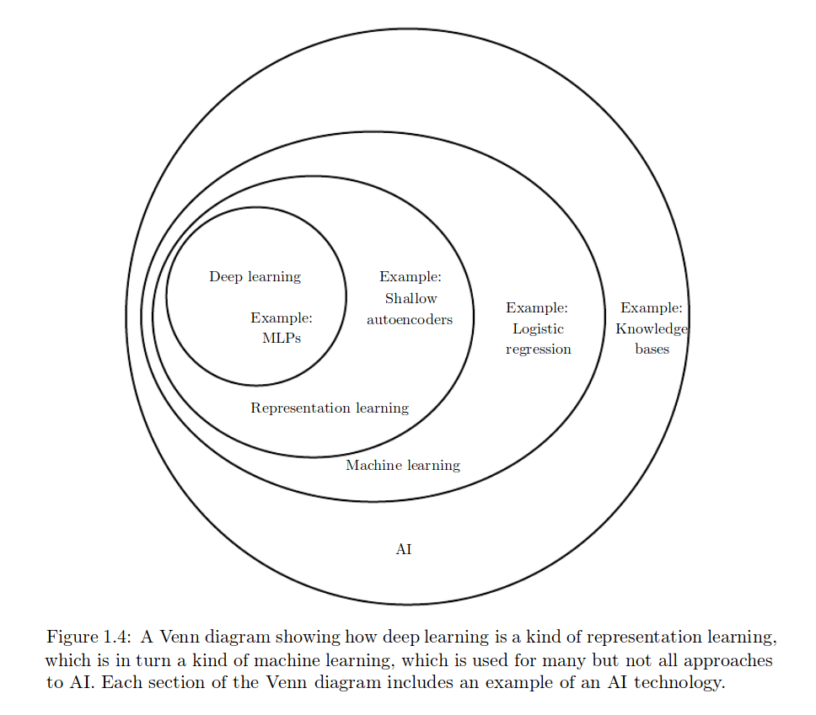

Slide 5
1. Learning Problem

Slide 6
1.1 What is Machine Learning
Learning
Problem
1.2 Key Essence of Machine Learning
1.3 Learning Flow
1.4 Type of Learning

Slide 7
1.1 What is ML
A computer program is said to learn from experience E with respect to some class of tasks T and performance measure P , if its performance at tasks in T , as measured by P , improves with experience E .
—— Mitchell(1997)
1. Learning Problem

Slide 8
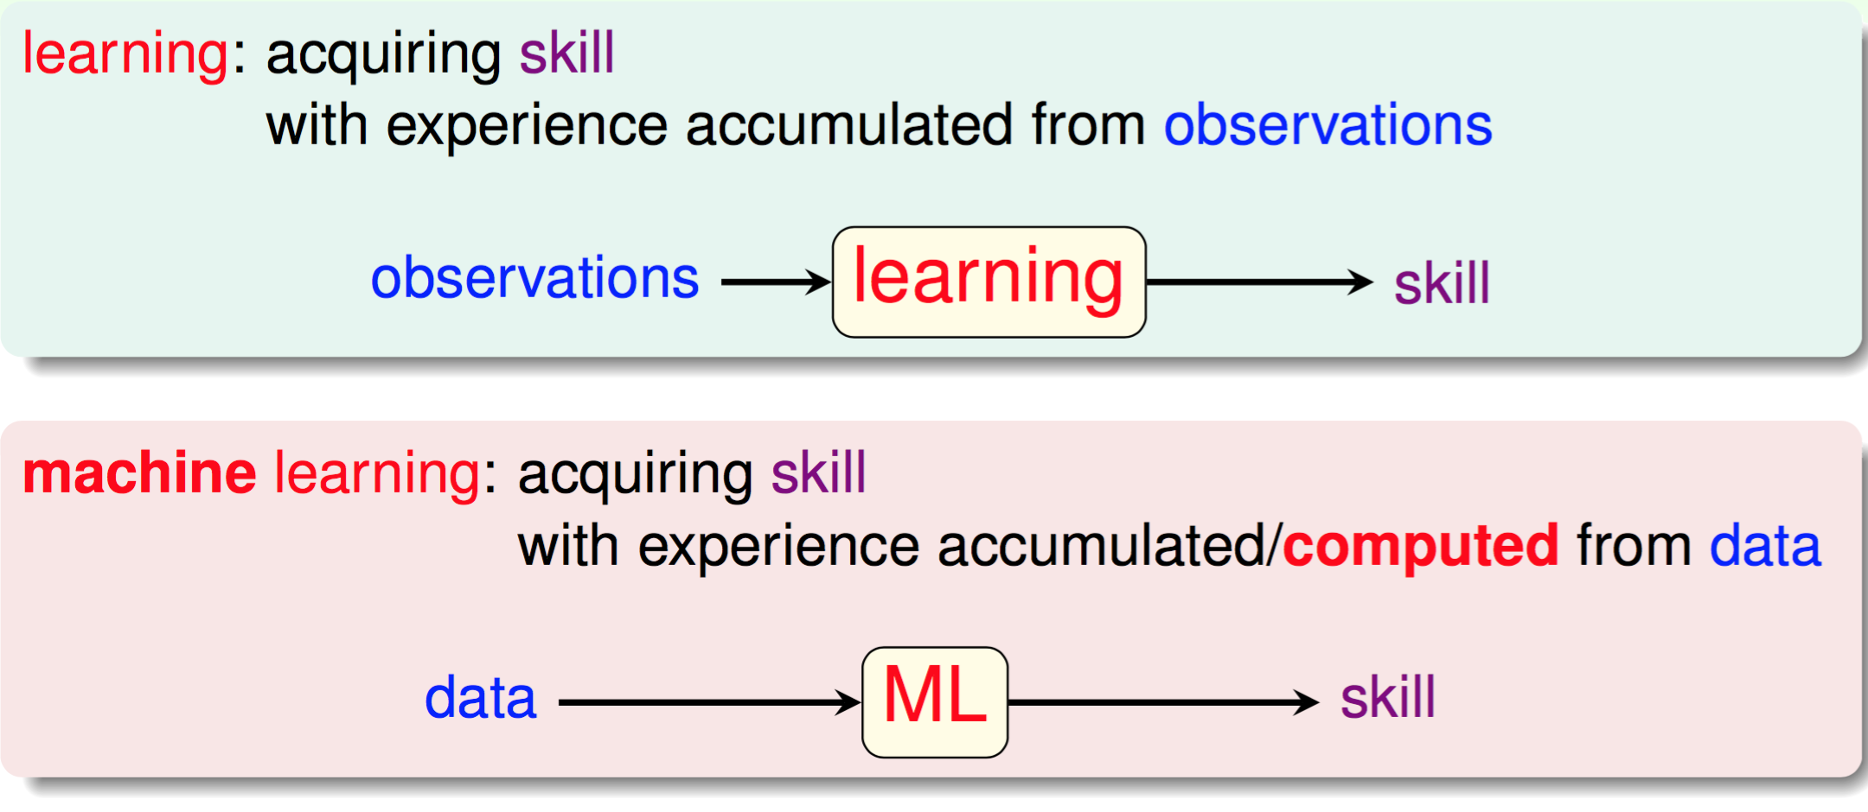
1.1 What is ML
1. Learning Problem

Slide 9
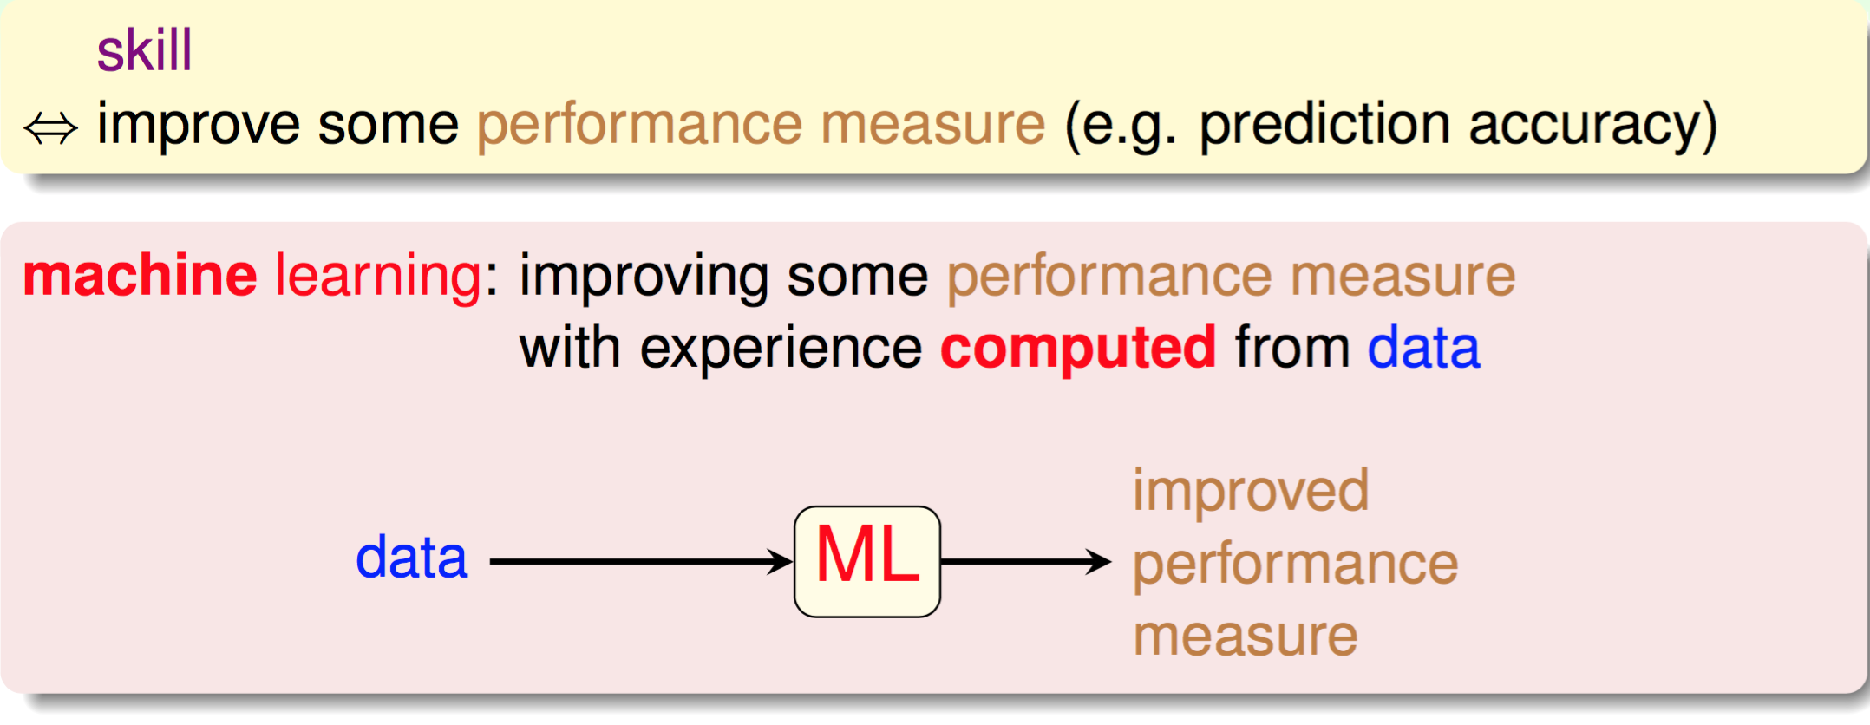
1.1 What is ML
1. Learning Problem
Notes:
最常见的任务：分类、回归

Slide 10
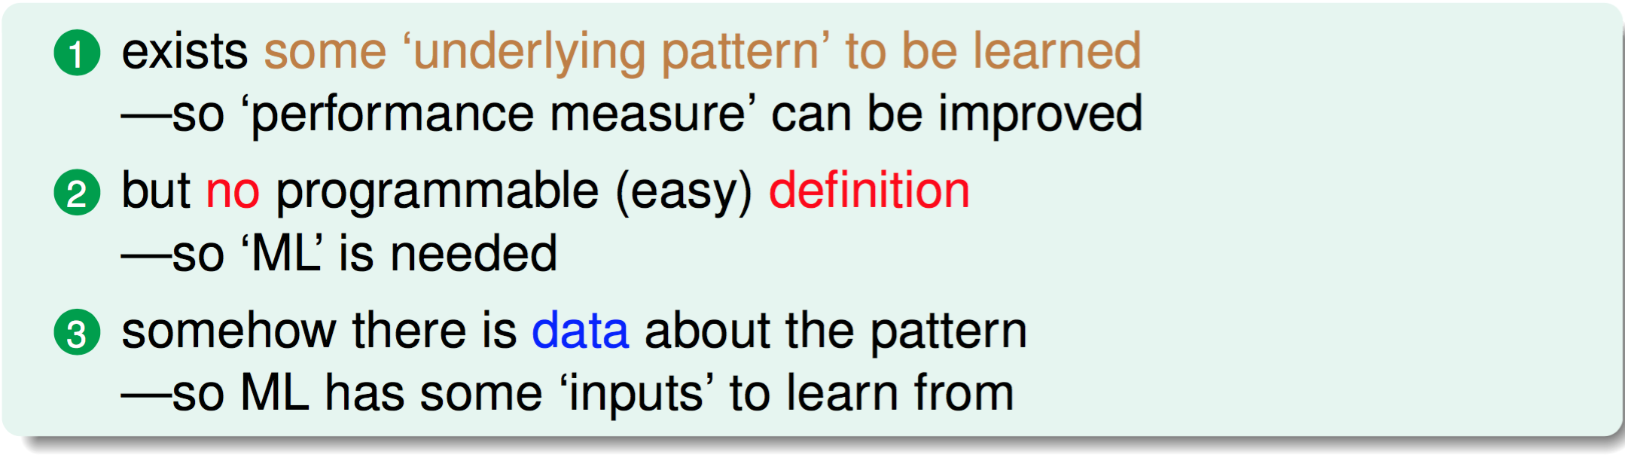
1.2 Key Essence of Machine Learning
1. Learning Problem
Notes:
不要为了ML 而ML
工业界常用规则的方式
规则的问题：1. 太多，情况复杂 多变 2. 规则太多往往规则之前容易矛盾（第一章介绍） 3. 有些事物无法用规则来写
规则的好处：可解释性强

Slide 11
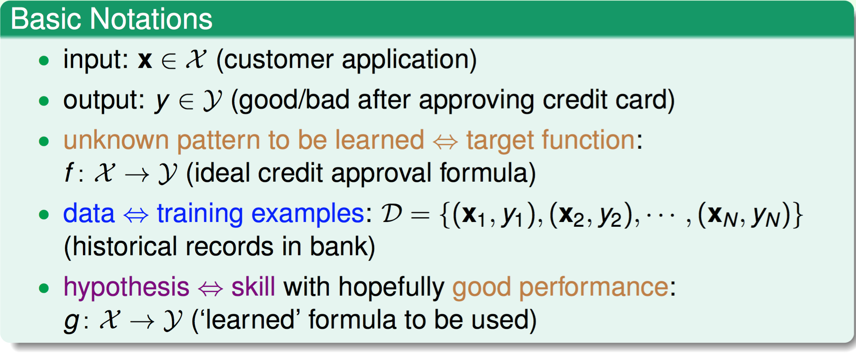

1.3 Components of Machine Learning
1. Learning Problem

Slide 12
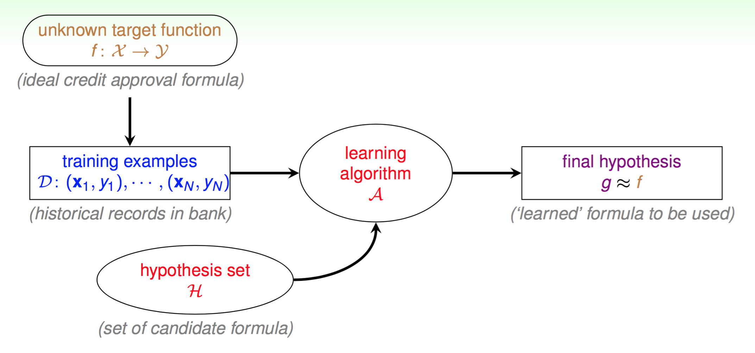
1.3 Components of Machine Learning
1. Learning Problem
Notes:
Model 和 Algorithm的区别
只是一个部分的Learning Flow

Slide 13
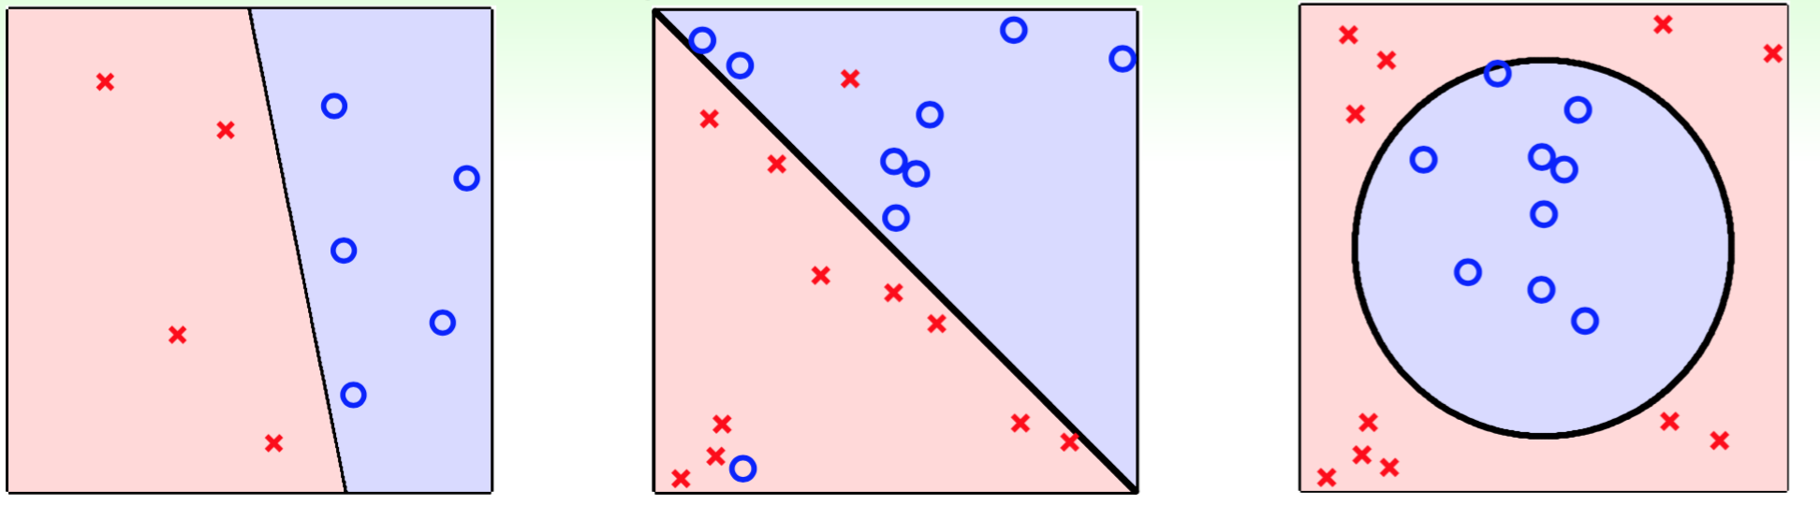
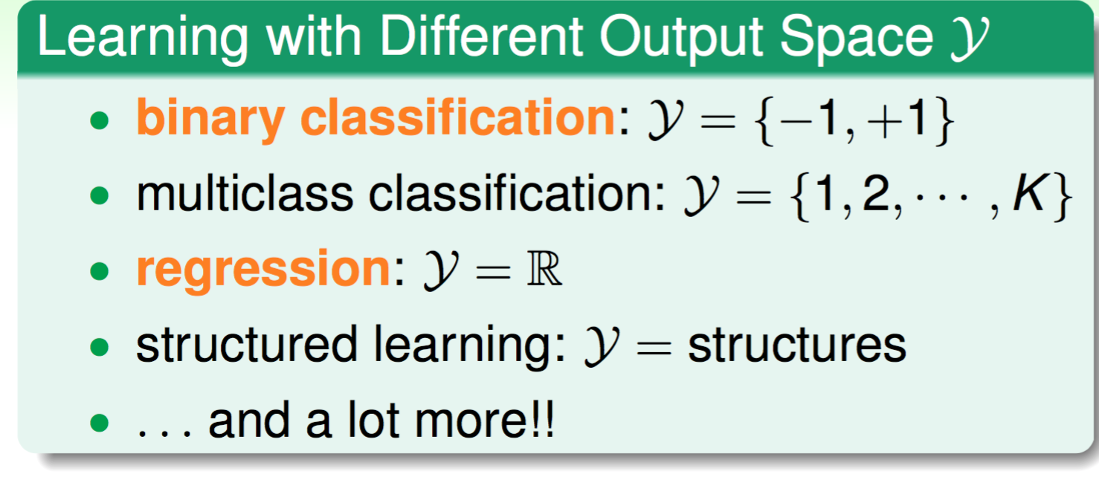
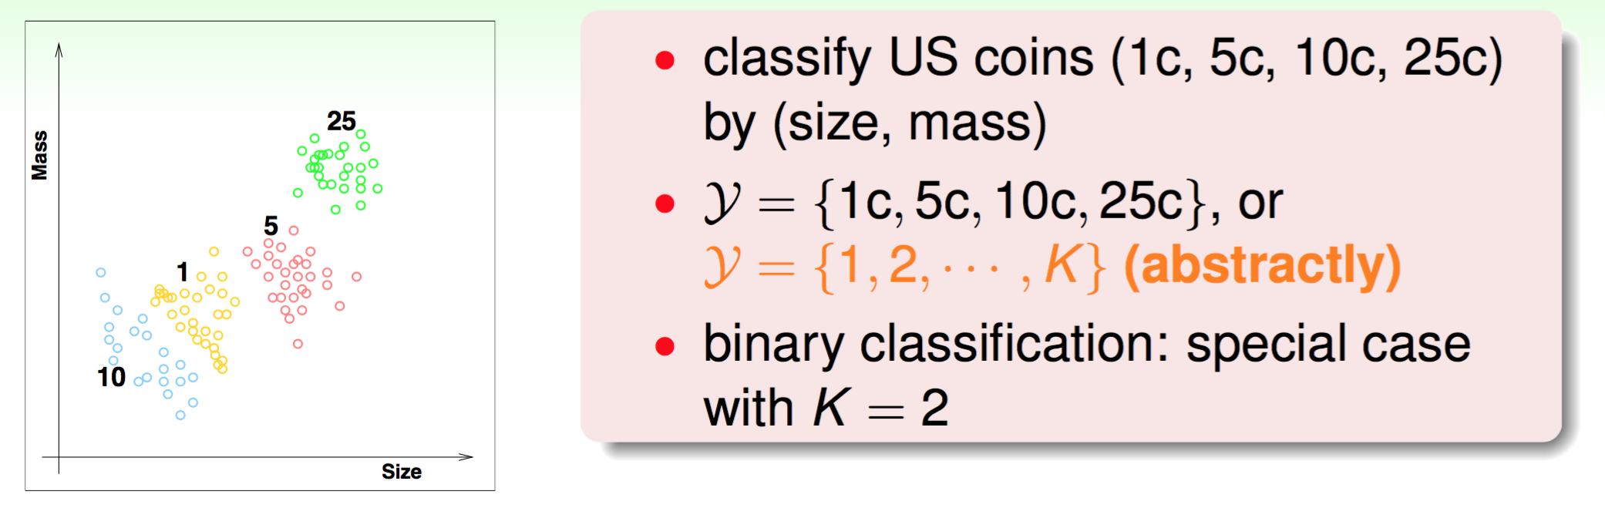
1.4 Type of Learning
1. Learning Problem

Slide 14
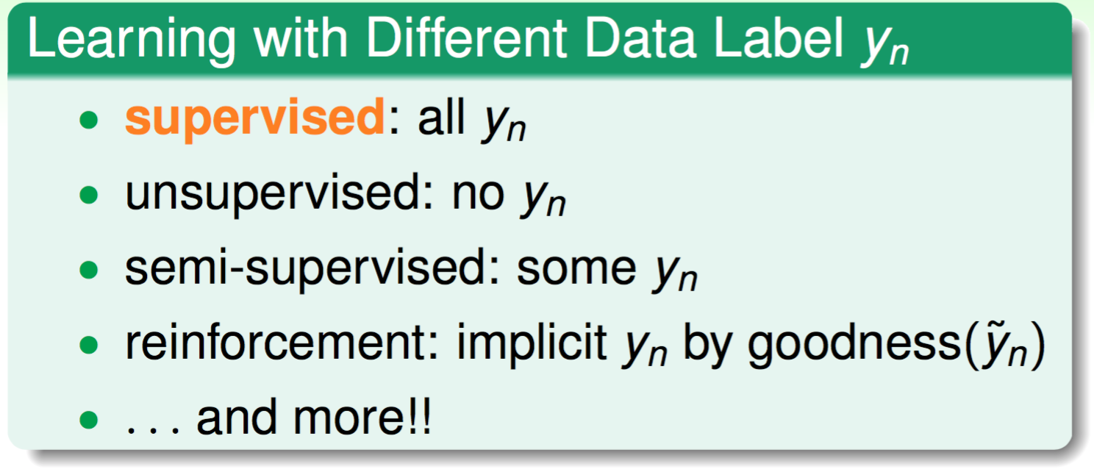
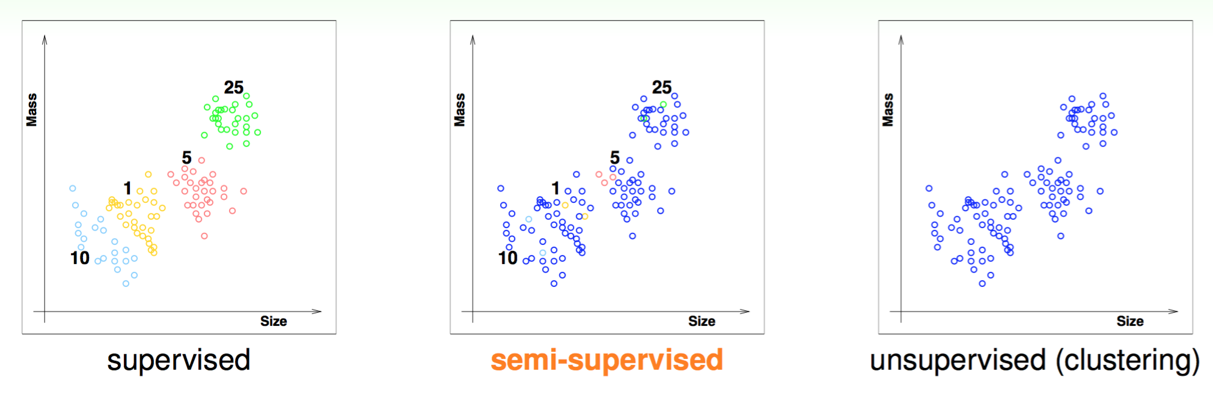
1.4 Type of Learning
1. Learning Problem

Slide 15
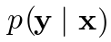
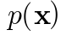
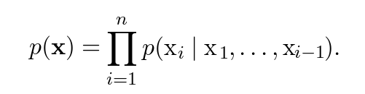
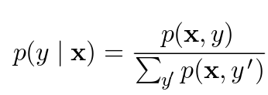
1.4 Type of Learning
supervised Learning
unsupervised Learning
1. Learning Problem
Notes:
监督学习和无监督学习的界限是模糊的，很多机器学习技术可以用到这两个任务
链式法则：可以看成是无监督学习到监督学习的转换
条件概率公式：可以看成是监督学习到无监督学习的转换

Slide 16
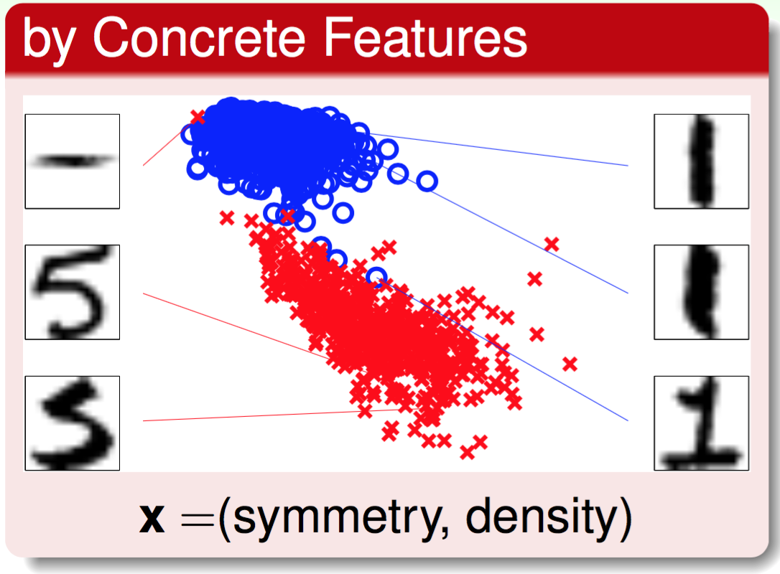
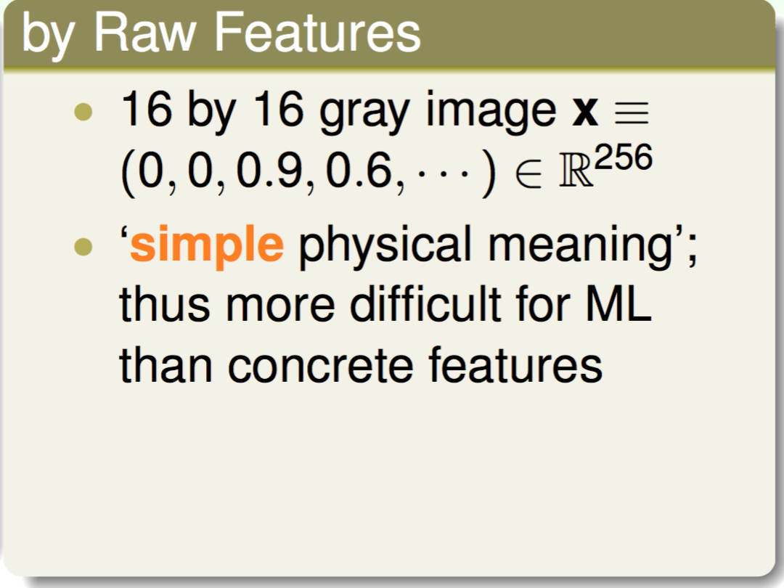
1.4 Type of Learning
1. Learning Problem

Slide 17
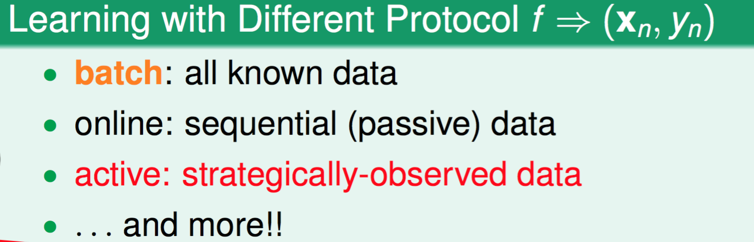
1.4 Type of Learning

Slide 18
2. Theory of Generalization

Slide 19
2.1 No Free Lunch
Theory of
Generalization
2.2 VC Theory
2.3 Bias &Variance
2.4 Learning Curve

Slide 20
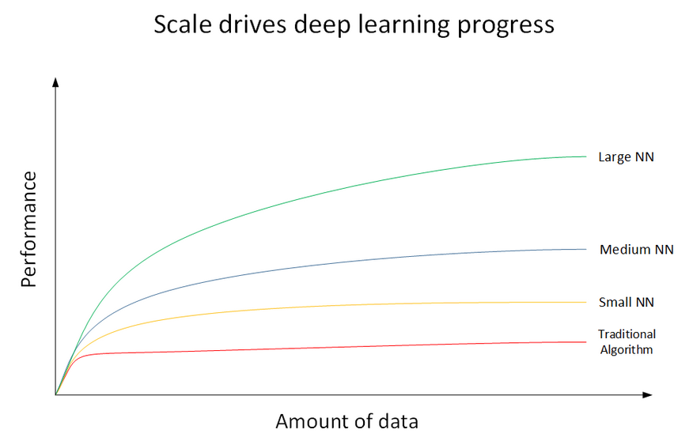

Slide 21
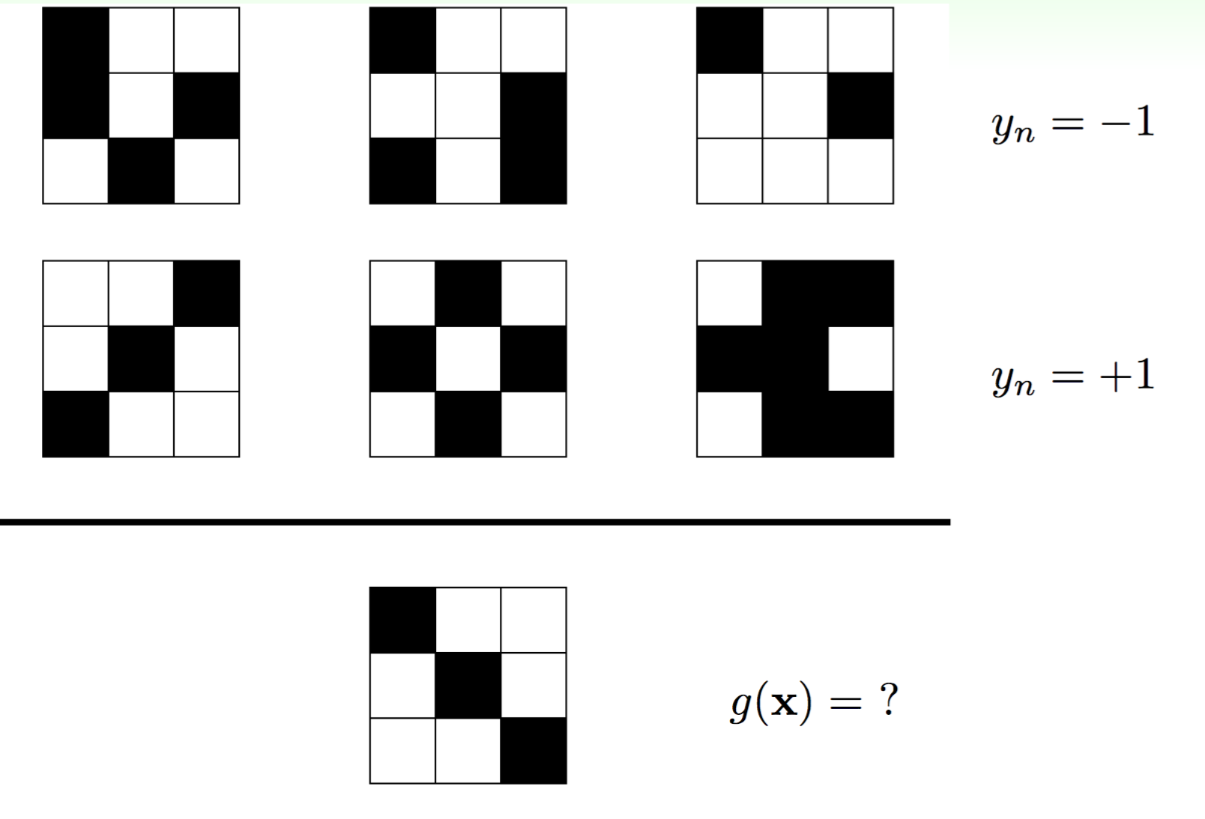
2.1 No Free Lunch
2. Theory of Generalization

Slide 22
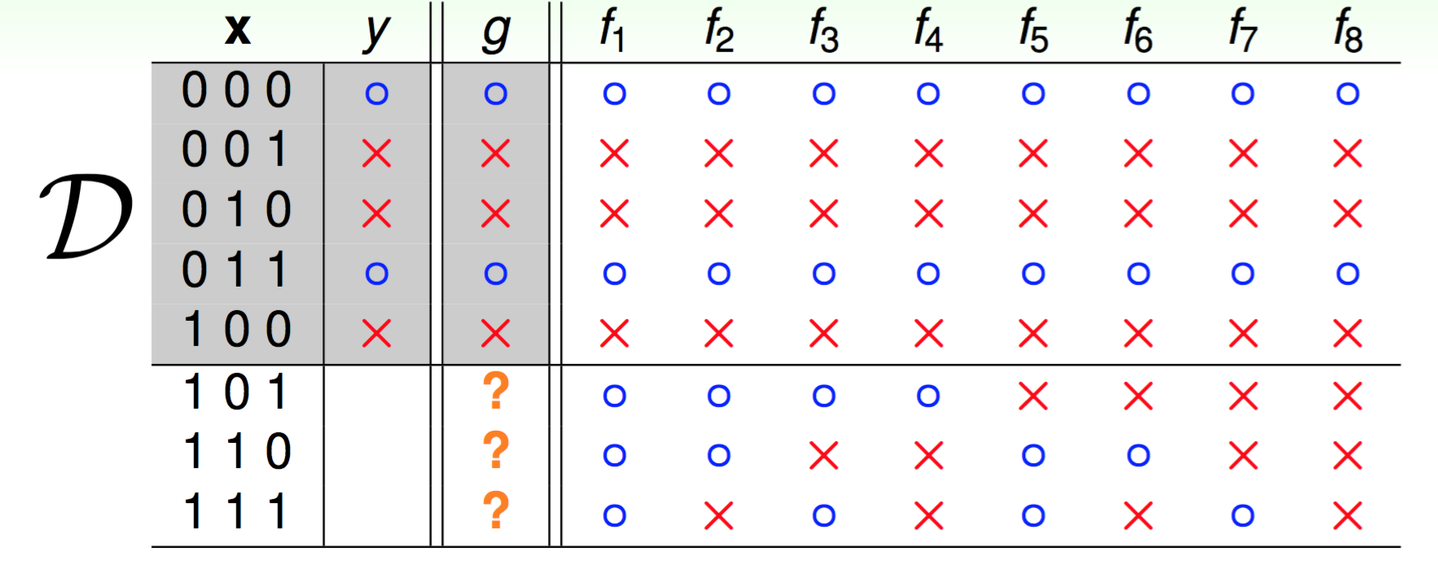
2.1 No Free Lunch
2. Theory of Generalization

Slide 23
2.2 VC Theory
2. Theory of Generalization

Slide 24
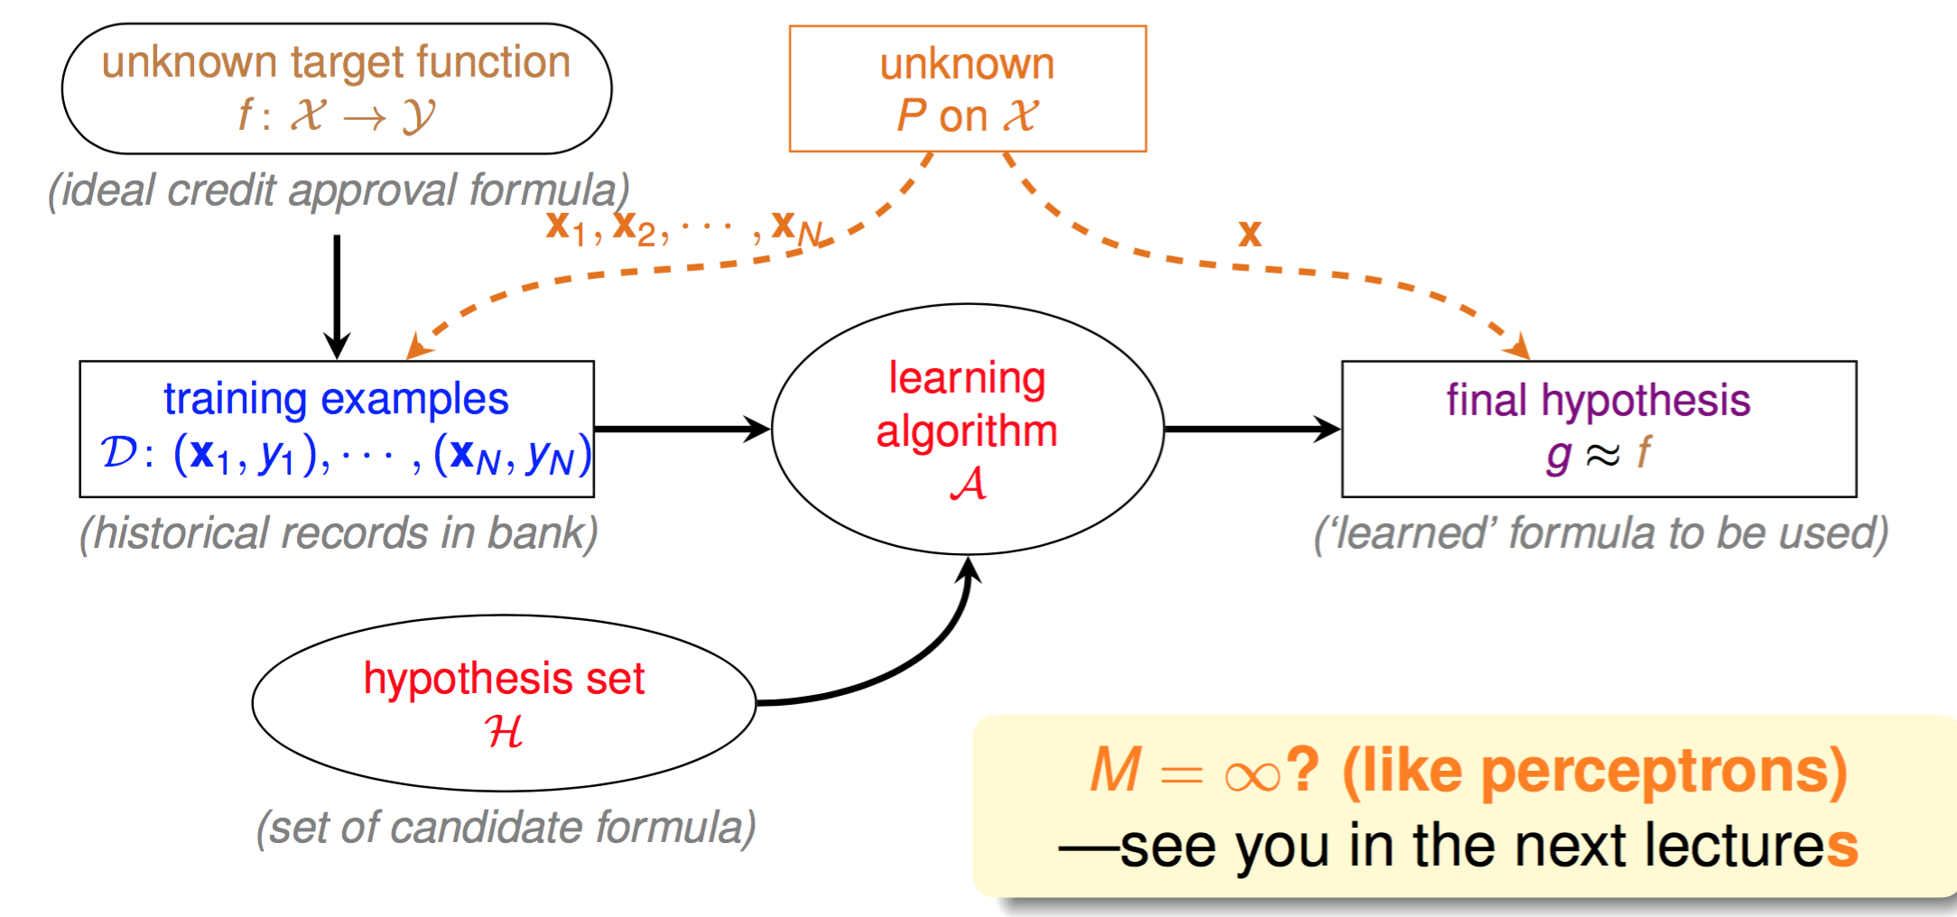
2.2 VC Theory

Slide 25
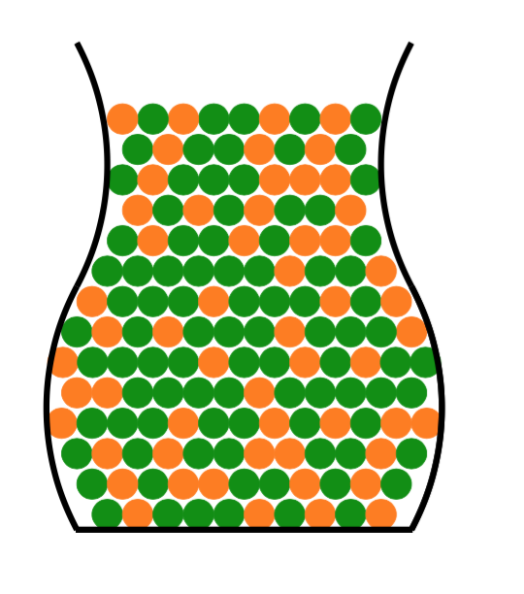

2.2 VC Theory
Notes:
VC 理论，也是泛化理论

Slide 26
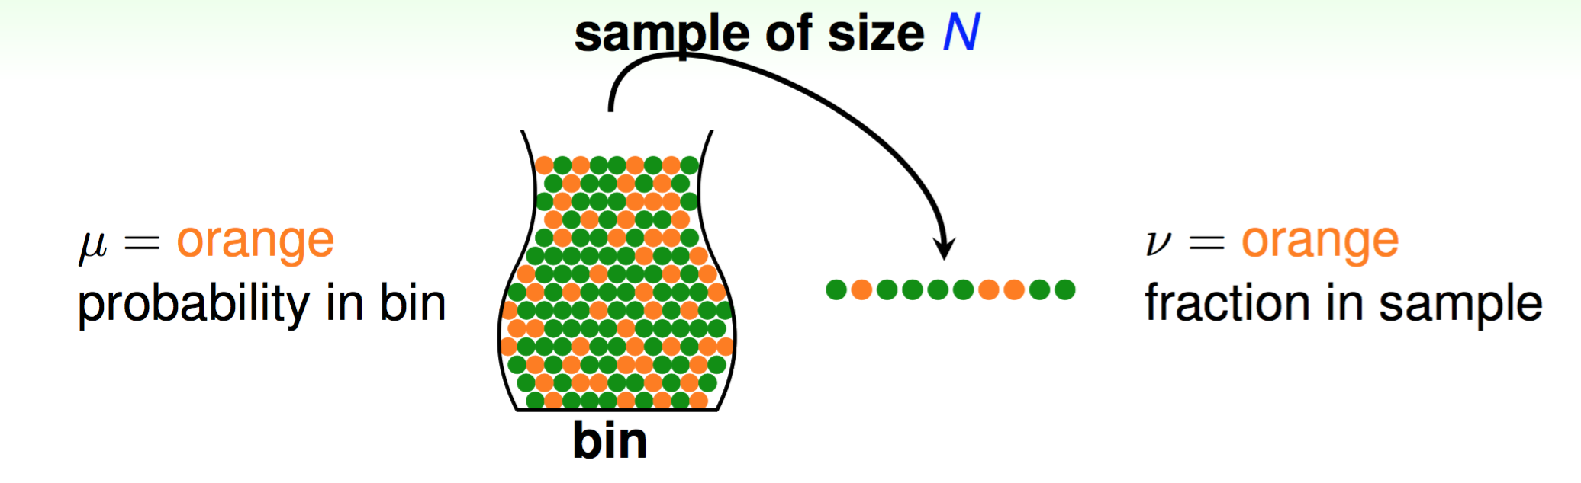
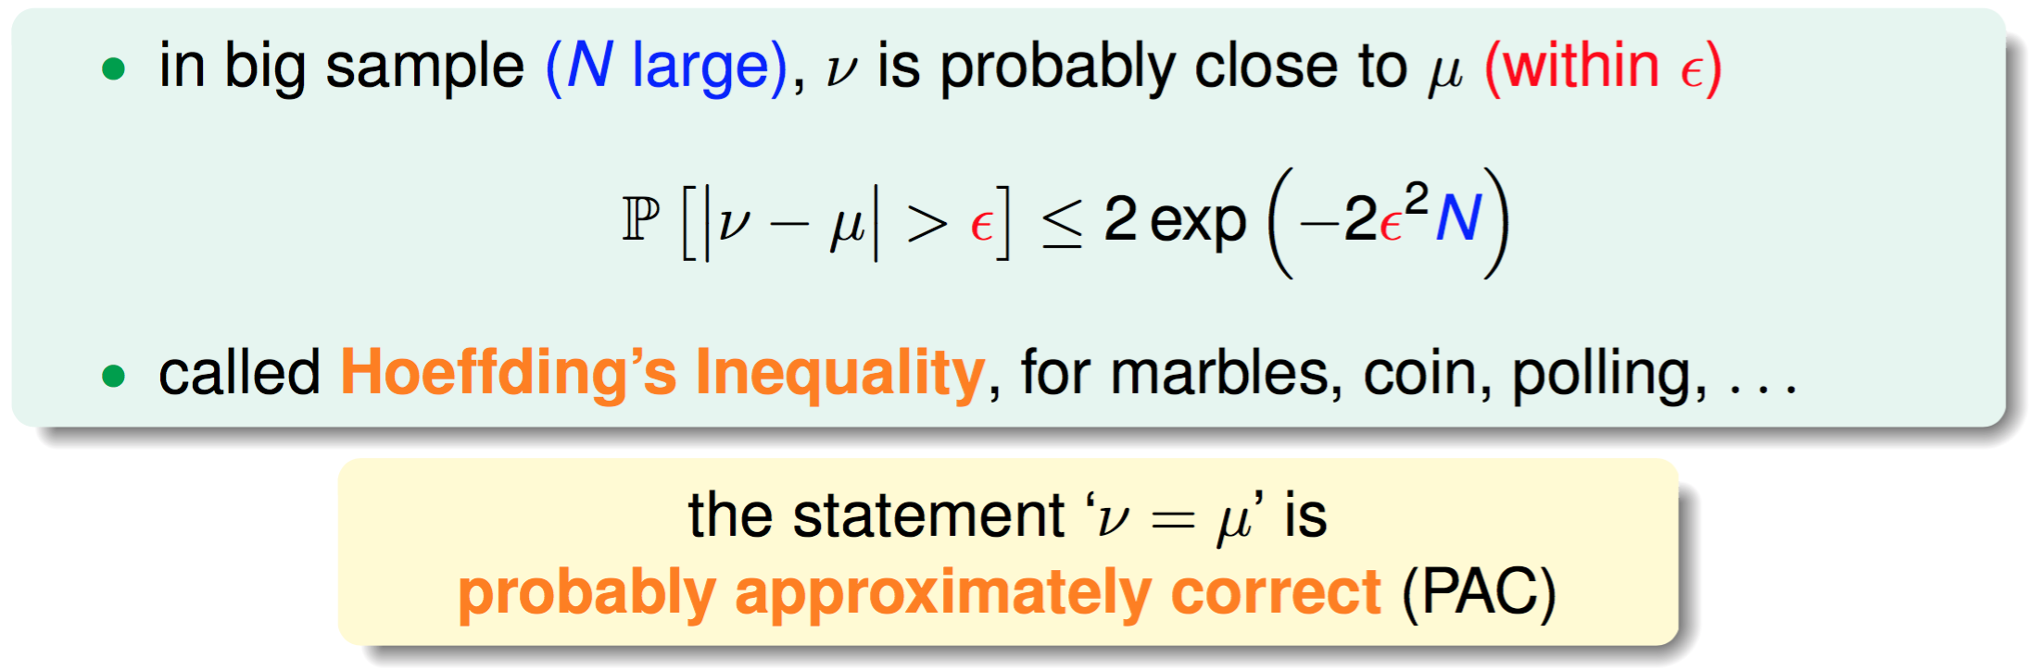

Slide 27
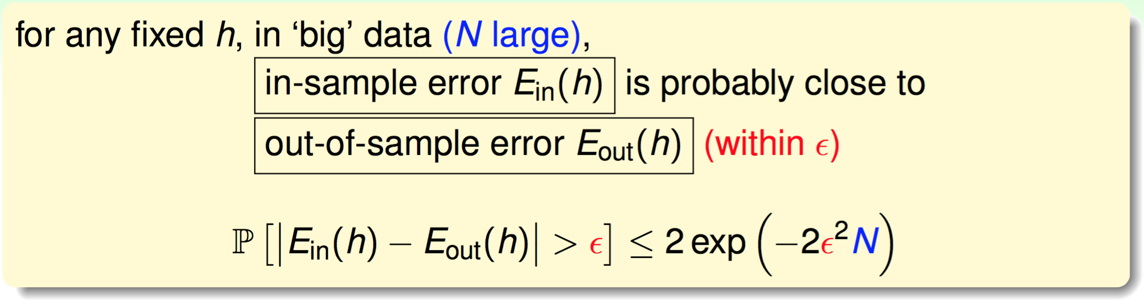
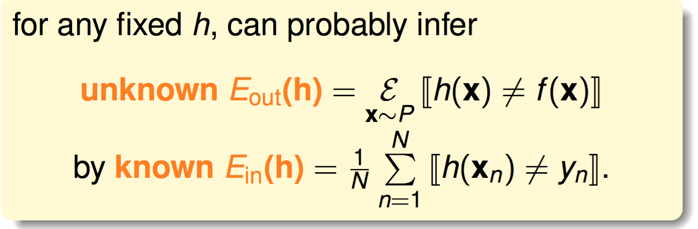
2.2 VC Theory

Slide 28
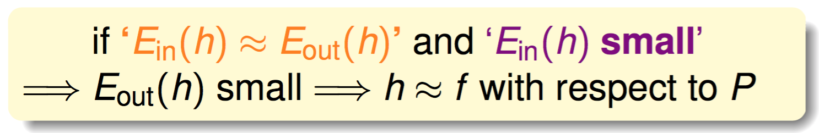
2.2 VC Theory

Slide 29

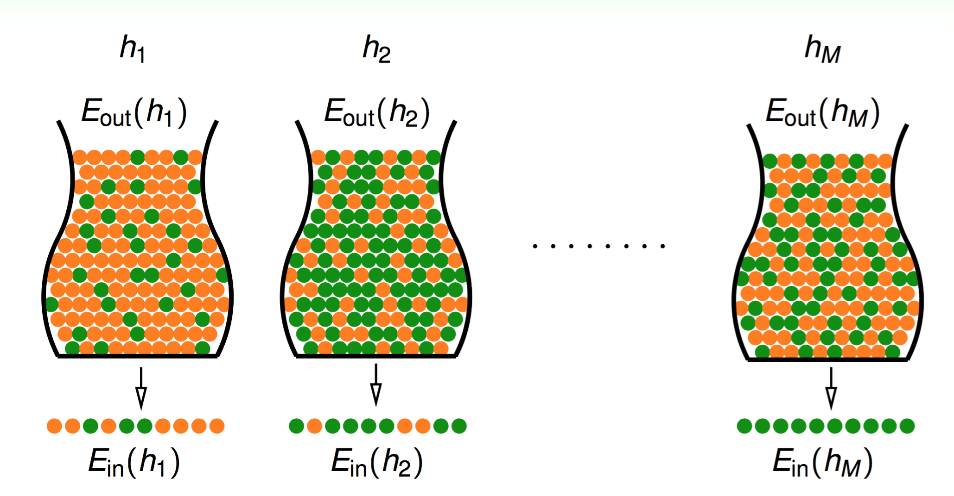
2.2 VC Theory

Slide 30
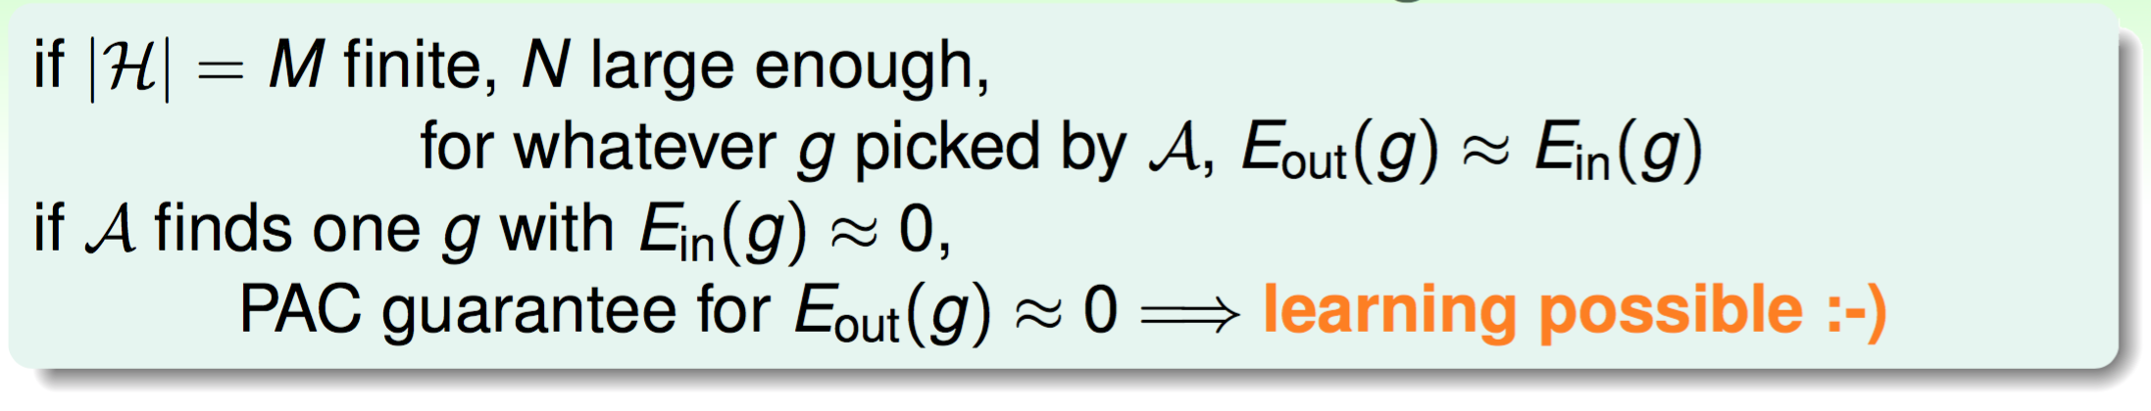
2.2 VC Theory

Slide 31
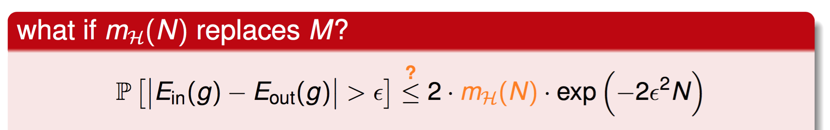
2.2 VC Theory

Slide 32
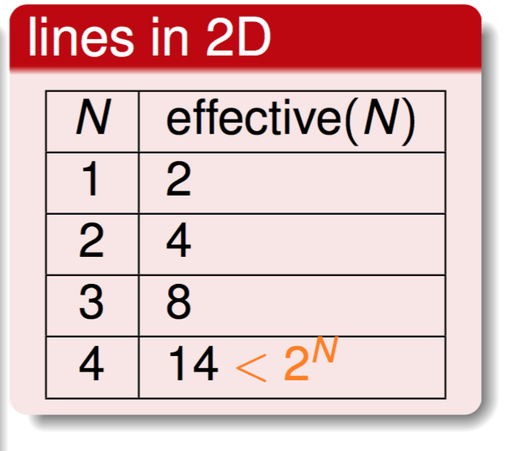
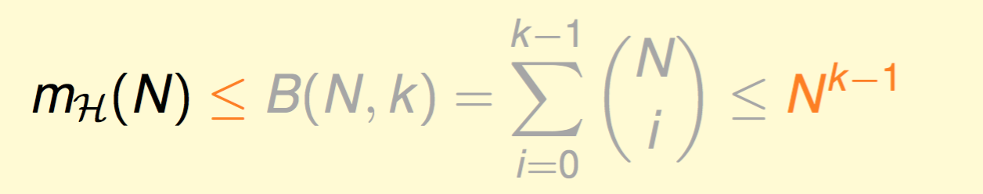
2.2 VC Theory

Slide 33
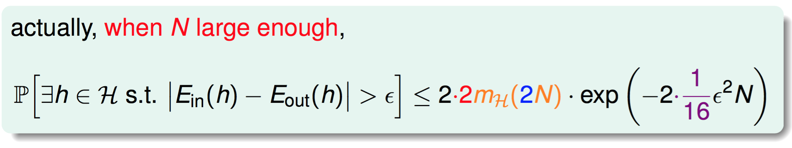
2.2 VC Theory

Slide 34
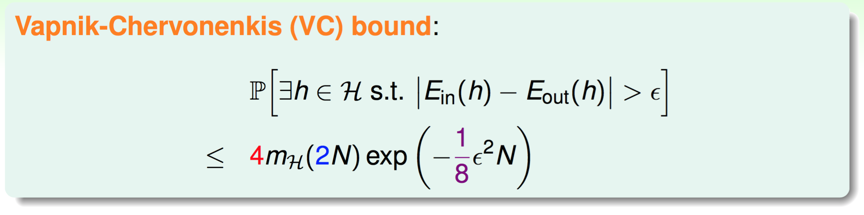
2.2 VC Theory

Slide 35
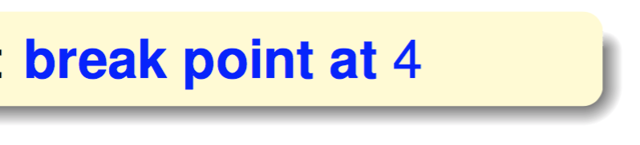
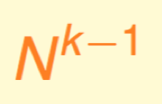
2.2 VC Theory
K

Slide 36
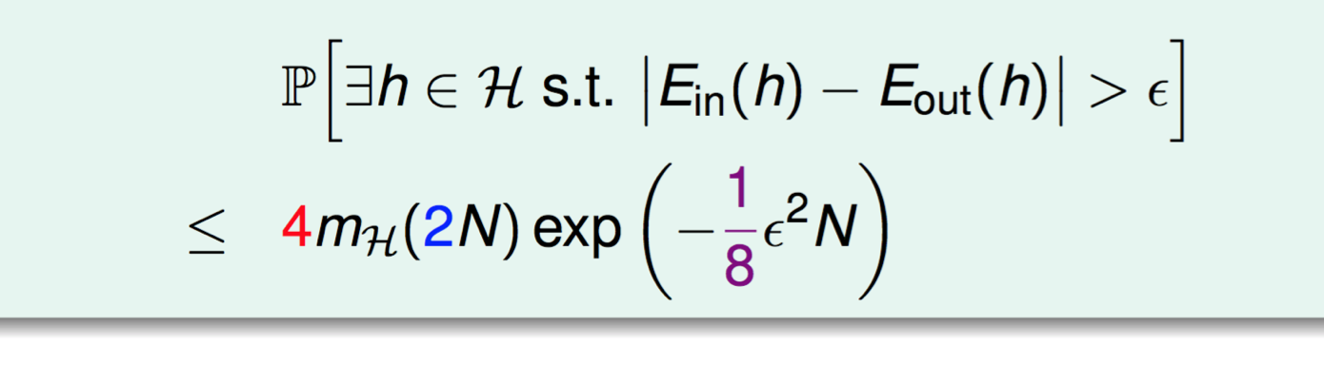
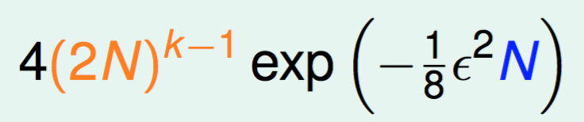
2.2 VC Theory

Slide 37

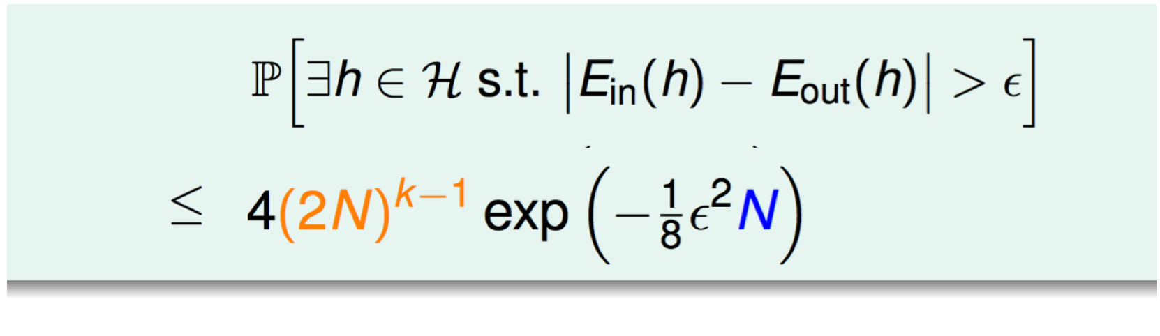
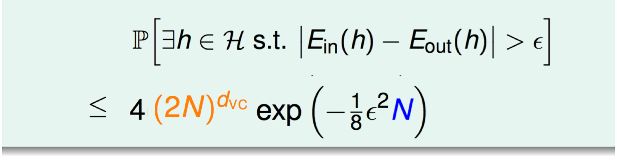
2.2 VC Theory
Notes:
下面说VC维的三个关键点

Slide 38
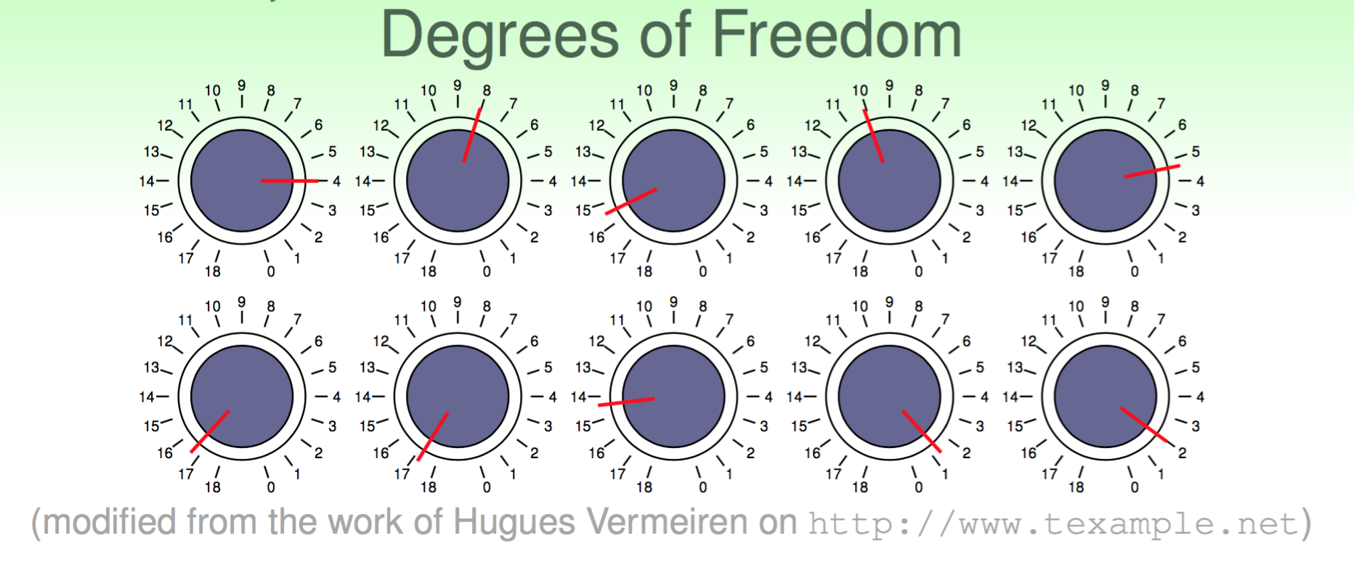
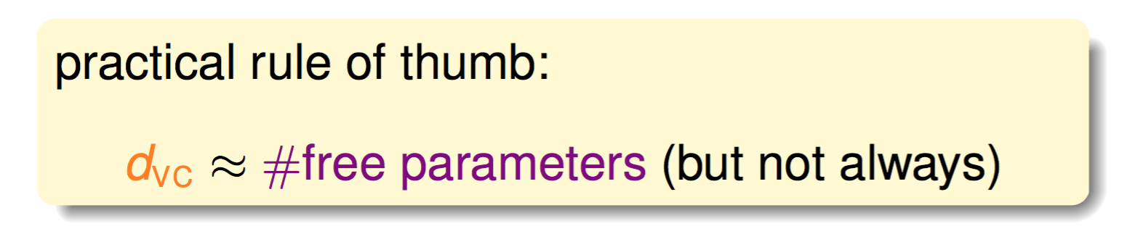
2.2 VC Theory
Notes:
VC维的物理意义
数值上约等于自由参数的个数

Slide 39
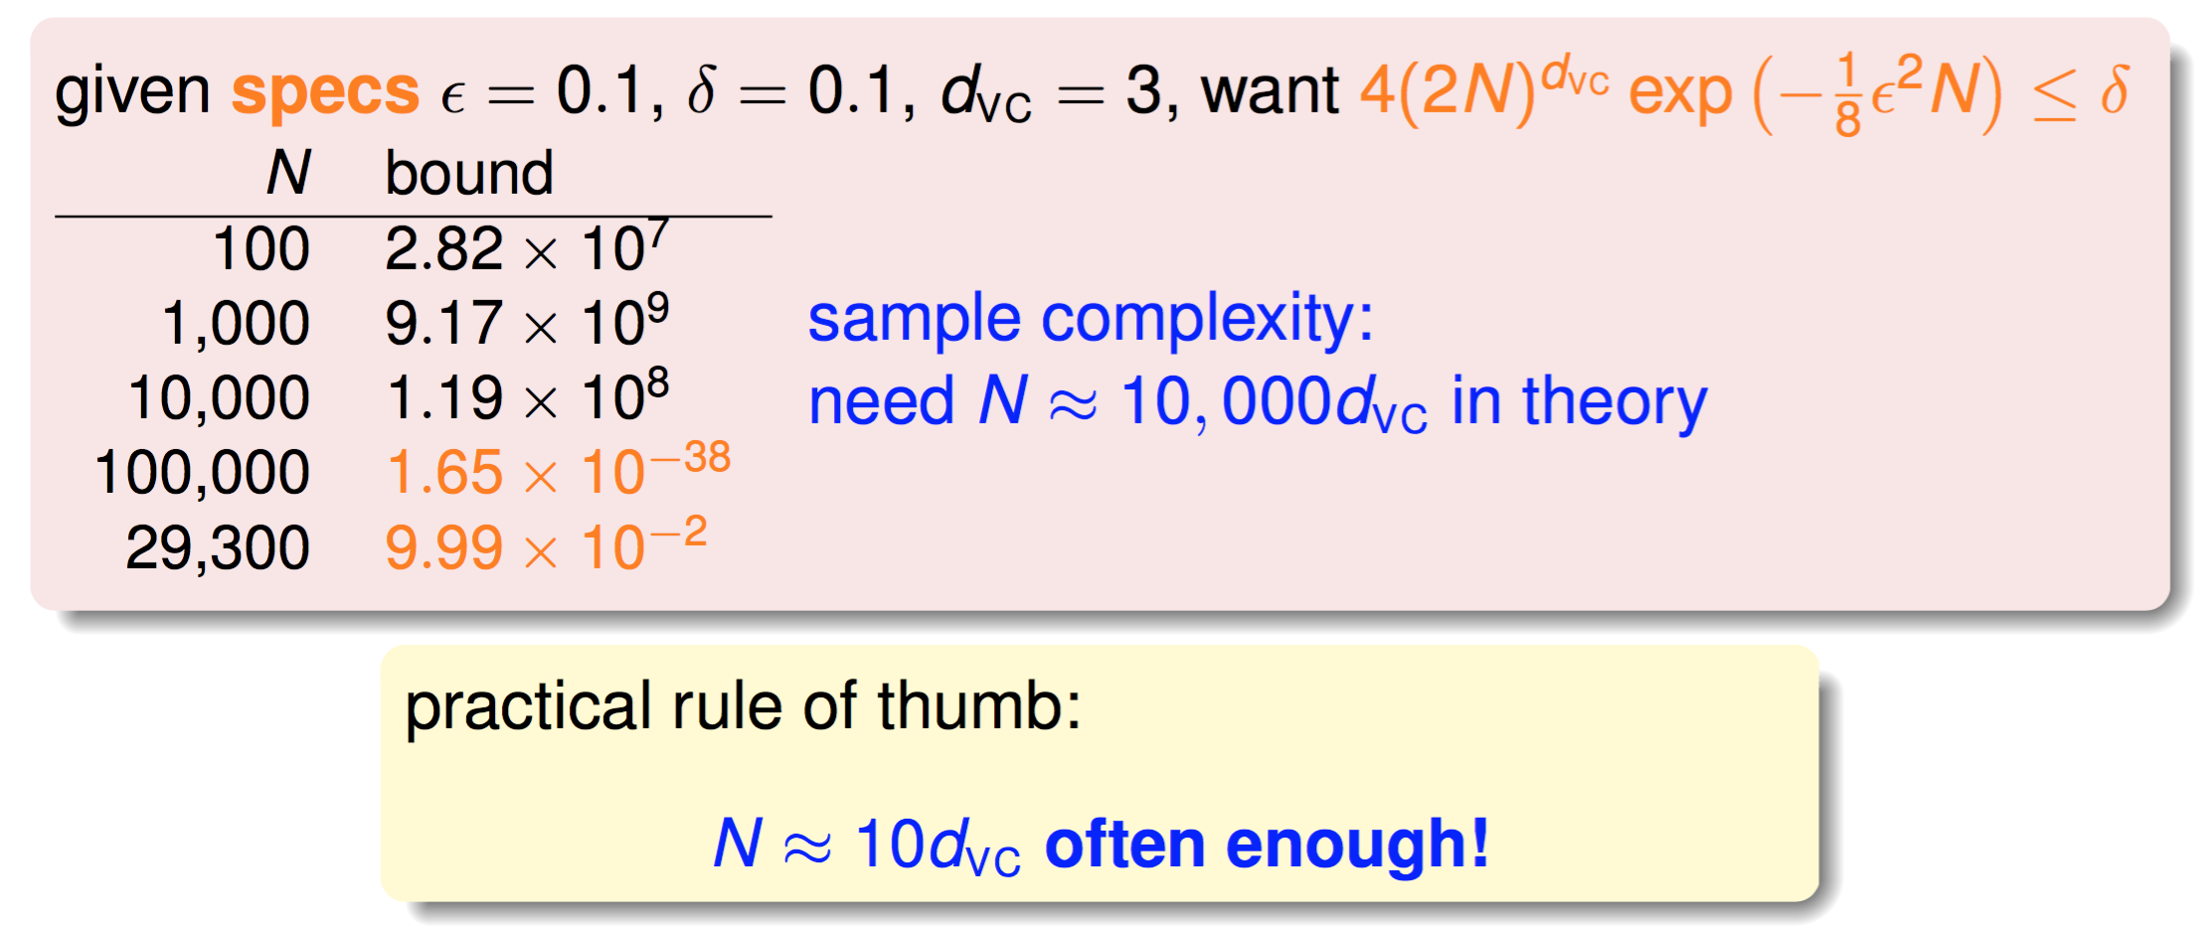
2.2 VC Theory
Looseness of VC Bound
Notes:
2. VCBound的应用 二维空间
另外一点，样本数要比特征数大

Slide 40
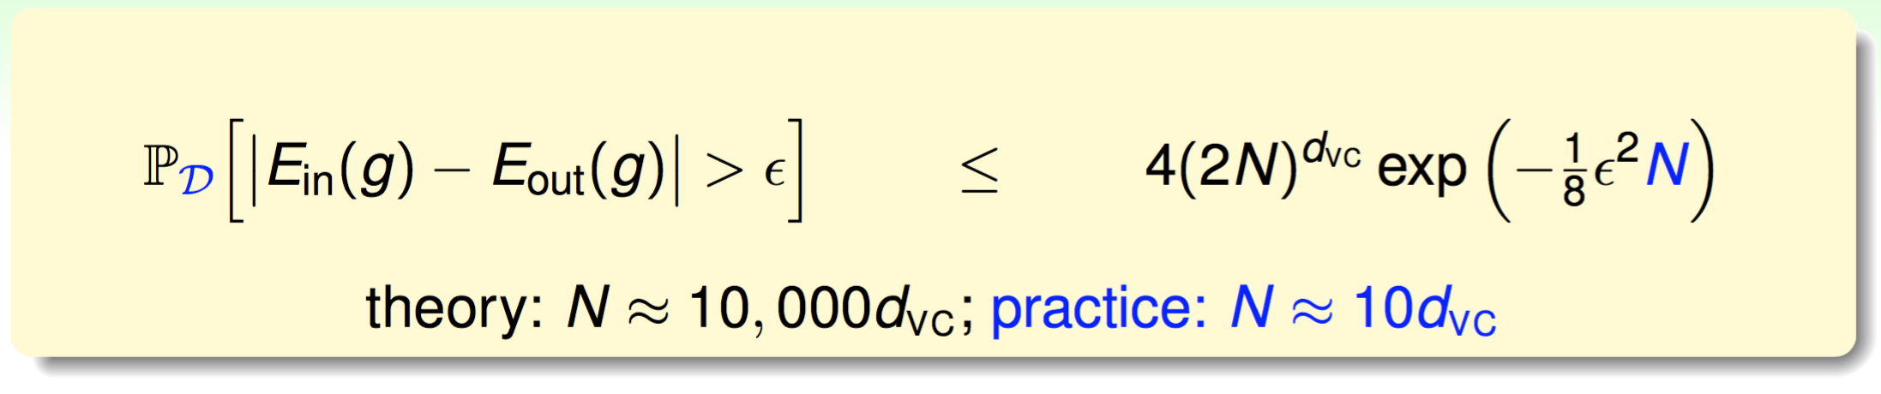
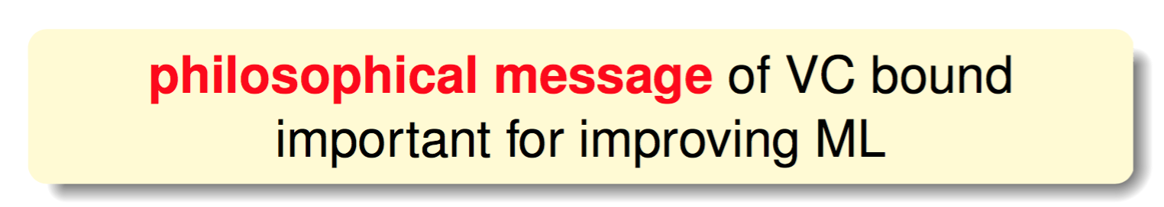
2.2 VC Theory
Notes:
更关注哲学意义

Slide 41
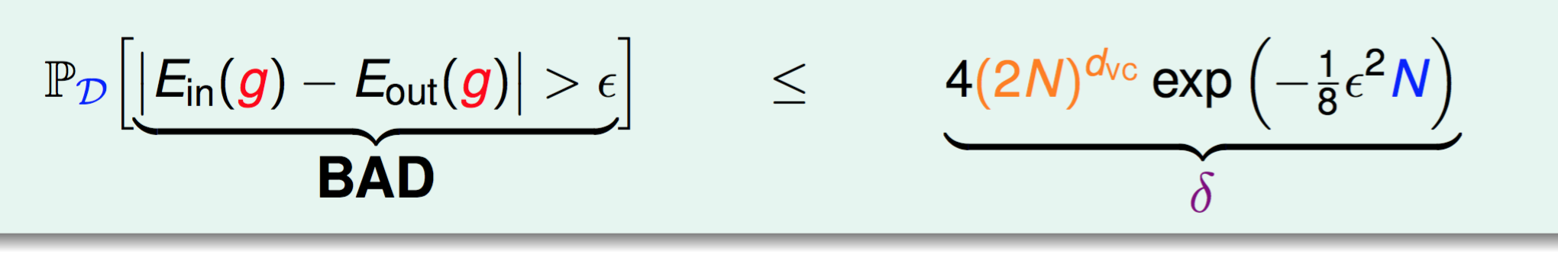
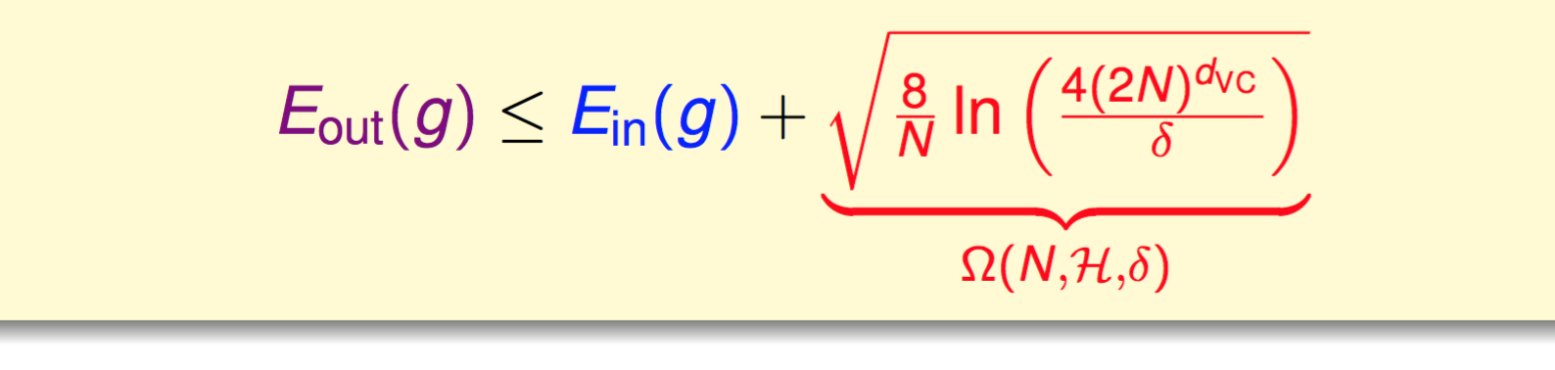
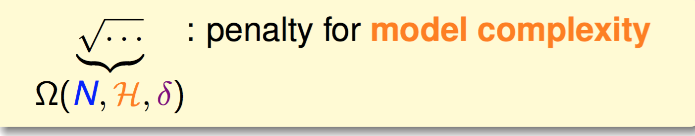
2.2 VC Theory

Slide 42

2.2 VC Theory
Notes:
补充：
深度学习中的VC理论缺陷：
bound太宽松
深度模型实际的vc维不好确定

Slide 43

2.3 Bias & Variance
Notes:
1. 偏差. 这里的偏指的是 偏离 , 那么它偏离了什么到导致了误差? 潜意识上, 当谈到这个词时, 我们可能会认为它是偏离了某个潜在的 “标准”, 而这里这个 “标准” 也就是真实情况 (ground truth). 在分类任务中, 这个 “标准” 就是真实标签 (label).
2. 方差. 很多人应该都还记得在统计学中, 一个随机变量的方差描述的是它的离散程度, 也就是该随机变量在其期望值附近的 波动程度 . 取自维基百科一般化的方差定义:

Slide 44

Notes:
西瓜书 45页

Slide 45

2.3 Bias & Variance
Notes:
1. 偏差. 偏差度量了学习算法的期望预测与真实结果的偏离程序, 即 刻画了学习算法本身的拟合能力 .
2. 方差. 方差度量了同样大小的训练集的变动所导致的学习性能的变化, 即 刻画了数据扰动所造成的影响 .
3. 噪声. 噪声表达了在当前任务上任何学习算法所能达到的期望泛化误差的下界, 即 刻画了学习问题本身的难度 . 巧妇难为无米之炊, 给一堆很差的食材, 要想做出一顿美味, 肯定是很有难度的.
往往 偏差 和 方差是有冲突的

Slide 46

2.3 Bias & Variance

Slide 47

2.3 Learning Curve
2. Theory of Generalization
Notes:
Bayes error

Slide 48
3. Over-fitting & Validation

Slide 49
3.1 What is over-fitting
Over-fitting
&
Validation
3.2 The reason of over-fitting
3.3 How to avoid over-fitting

Slide 50




3.1 What is over-fitting
3. Over-fitting & Validation

Slide 51

3.1 What is over-fitting

Slide 52

3.1 What is over-fitting

Slide 53

3.1 What is over-fitting
3. Over-fitting & Validation
Notes:
严格上讲，过拟合 和 bad generalization 不是一个概念
但通常，把他们两个看做一回事
Bayes error

Slide 54

3.1 What is over-fitting

Slide 55

3.1 What is over-fitting

Slide 56


3.2 The reason of over-fitting

Slide 57


Slide 58

3.2 The reason of over-fitting
Notes:
下一页贝叶斯误差

Slide 59
3.2 The reason of over-fitting
The‭ ‬error‭ ‬incurred‭ ‬by‭ ‬an‭ ‬oracle‭ ‬making‭ ‬predictions‭ ‬from‭ ‬the‭ ‬true distribution‭ p‭(‭x‬‬,‭ ‬y‭)‭ ‬‬‬is‭ ‬called‭ ‬the‭ Bayes‭ ‬error‬

Slide 60
3.2 The reason of over-fitting
Notes:
贝叶斯误差

Slide 61

3.2 The reason of over-fitting

Slide 62


Slide 63


Slide 64
3.2 The reason of over-fitting
The‭ ‬error‭ ‬incurred‭ ‬by‭ ‬an‭ ‬oracle‭ ‬making‭ ‬predictions‭ ‬from‭ ‬the‭ ‬true distribution‭ p‭(‭x‬‬,‭ ‬y‭)‭ ‬‬‬is‭ ‬called‭ ‬the‭ Bayes‭ ‬error‬

Slide 65

Notes:
画整合在一起的learning curve
注意数据量 与 最佳dvc的关系
1. 第一种情况： 换用复杂的模型，performance 提升了
2. 第二种情况： 换用复杂的模型，performance 下降了
既然想提高复杂度，肯定是对当前的情况不满意： 提升了反倒变差了，怎么办？

Slide 66
Notes:
解释一下

Slide 67
3.2 The reason of over-fitting
Use excessive d_vc
Noise
Limited data size N
Notes:
这是在传统机器学习领域的一些说法
在深度学习，也许还有一些比较矛盾的说法 比如，向训练集 中增加噪声 会减小过拟合

Slide 68
3.3 How to avoid over-fitting
Use excessive d_vc
Noise
Limited data size N
Start from simple model
data cleaning/pruning
data hinting
Regularization
Validation
3. Over-fitting & Validation
Notes:
Bayes error

Slide 69

3.3 How to avoid over-fitting[Regularization]
3. Over-fitting & Validation

Slide 70


3.3 How to avoid over-fitting[Regularization]

Slide 71

3.3 How to avoid over-fitting[Regularization]

Slide 72


3.3 How to avoid over-fitting [Regularization]

Slide 73

3.3 How to avoid over-fitting[Regularization]
Notes:
限制条件就是 W^TW

Slide 74


3.3 How to avoid over-fitting[Regularization]

Slide 75



Slide 76

3.3 How to avoid over-fitting[Regularization]

Slide 77

3.3 How to avoid over-fitting[Regularization]

Slide 78





3.3 How to avoid over-fitting[Regularization]
$$E_{in}$$
(N)
$$E_{out}$$
$$E_{val}$$
(k)
$$E_{train}$$
(N-k)
Large k
Small k
$$k= \frac{N}{5}$$

Slide 79

3.3 How to avoid over-fitting[Regularization]

Slide 80

3.3 How to avoid over-fitting[Regularization]

Slide 81

3.3 How to avoid over-fitting[Regularization]

Slide 82
3.3 How to avoid over-fitting[Regularization]
Leave one out ： K=1
Cross validation

Slide 83

3.3 How to avoid over-fitting[Regularization]

Slide 84

3.3 How to avoid over-fitting[Regularization]

